Slide 1
Who is the real winner of the Super Bowl halftime show?
Curtis Bishop

Slide 2
Outline
Introduction
Background
Challenges
Data
Model
Results
Conclusion

Slide 3
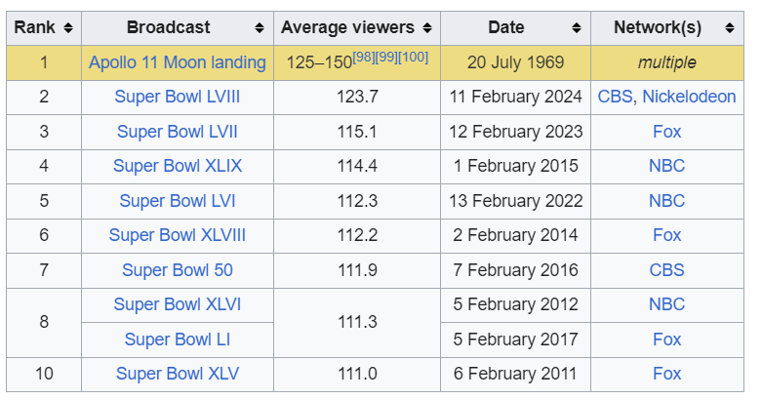
Why do we care?
The Super Bowl is one of the most viewed television events in the U.S. every year.
The halftime show is as a result almost certainly the most viewed live musical performance each year.
This analysis aims to explore the value of this exposure to the performers, as well as compare it to the value to the NFL that performers with larger fan bases may bring.
The outcomes of this analysis may prove valuable for cost-profit valuations of marketing expenditures in more general contexts.

Slide 4
Challenges :(
Through this point of the project there have been several setbacks that we aim to address in the future. They include:
Lack of disaggregated data from prior to 2017
Lack of NFL game viewership data
Lack of comprehensive artist compensation data
Data cleanliness and incompatible structure

Slide 5
Data
The Data that we have used has come from the following sources:
Statista
Wikipedia
Spotify Charts
HITS Daily Double
UK Official Charts
Web Archive
In order to retrieve data from these sites we utilized tools such as selenium webdriver, beautifulsoup4, and the Internet Archive wayback machine in order to retrieve data going back as far as possible.
So far we have collected a sufficient amount of artist data from 2017-present. However data prior to that, as well as data about NFL viewership has been scarce.

Slide 6
Model
Due to the nature of our analysis we have opted to utilize a relatively simple econometric modeling approach known as Difference-in-Difference.
We have chosen this approach since it is designed for this type of analysis, and the simple structure would improve our ability to convey results to the target audience of marketing and budget department members.
The measure of interest in this model is the difference between the treated and untreated groups differences across time.
The general structure of this model follows a simple linear regression with the following form:

Slide 7
y_{(t,p)}=β₀+β₁∗Post+β₂∗Treat+β₃∗(Post∗Treat)+ 𝞵

Slide 8
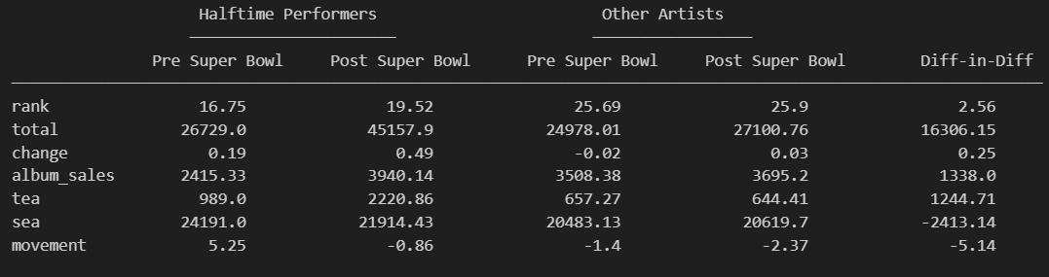
Results
Due to the slim amount of data that we have been able to access our model fails to achieve any statistical significance. However we have plans to address this through strategies such as bootstrapping and other variance reduction techniques. We also plan to devote more time to estimating financial gains associated with the measures collected so far.

Slide 9
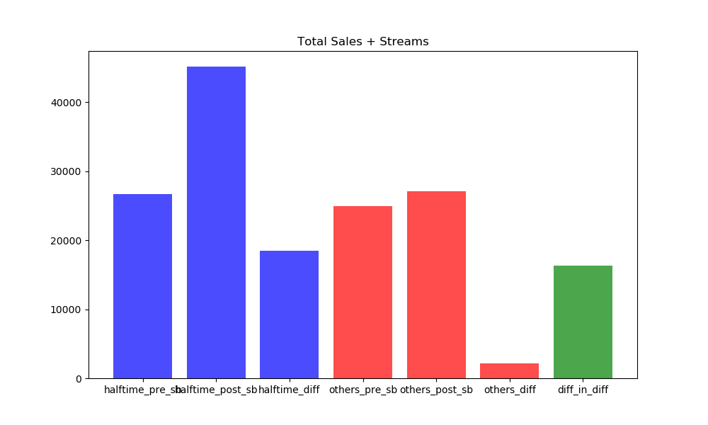
Total Sales + Streams

Slide 10
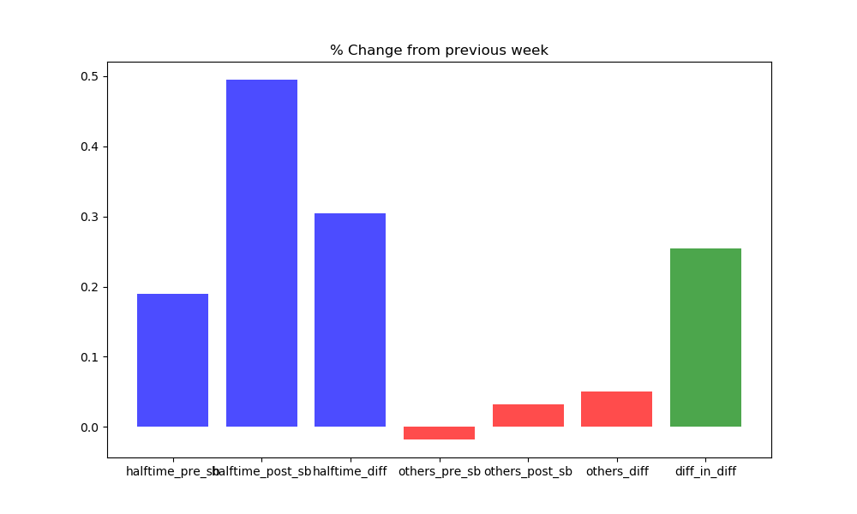
% Change from previous week

Slide 11
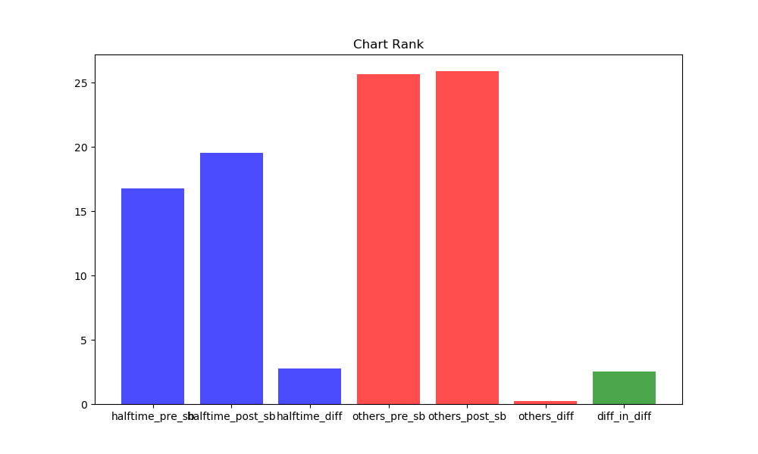
Change in Billboard Rank

Slide 12
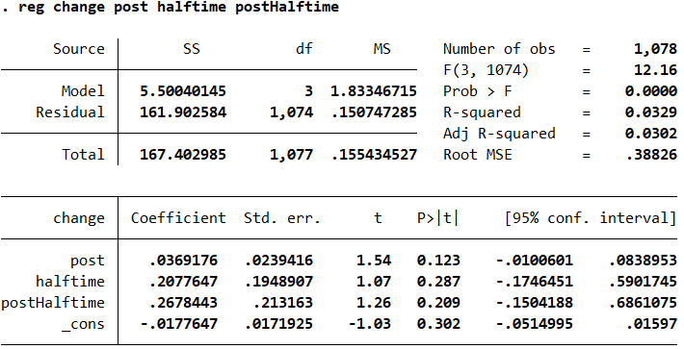
Diff-in-Diff regression with Change as dependent variable

Slide 13
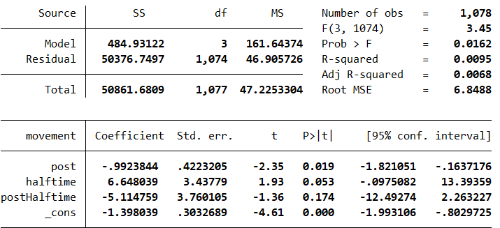
Diff-in-Diff regression with Movement as dependent variable

Slide 14
Questions or Feedback?

